Slide 1
Fundamentals of Pretrial Justice & New York City Supervised Release
March 31, 2016

Slide 2
Welcome!
Objectives:
Discuss the public safety impact of unnecessary detention
Overview of the current population detained in NYC
Description of new supervised release process and supervision structure

Slide 3
Effects of Detention
*Lowenkamp, C.T., VanNostrand, M., & Holsinger, A. (2013). The Hidden Costs of Pretrial Detention. Laura and John Arnold Foundation. New York City, NY.

Slide 4
State of the City Risk of Re-arrest for Felony Defendants with Bail Set or Remand
13

Slide 5
State of the City
Supervised Release pilot programs have been operating in NYC since 2009
Queens - CJA
Over 2,050 served since 8/09
Existing Supervised Release Pilots
Roughly 85% of these clients successfully complete supervised release requirements
Manhattan - CJA
Over 1,140 served since 4/13
Over 300 served since 11/13
Brooklyn - CCI

Slide 6
Supervised Release Eligibility
Defendants charged with misdemeanors and non-violent felony offenses
Defendants at high risk of felony pretrial re-arrest will not be considered

Slide 7
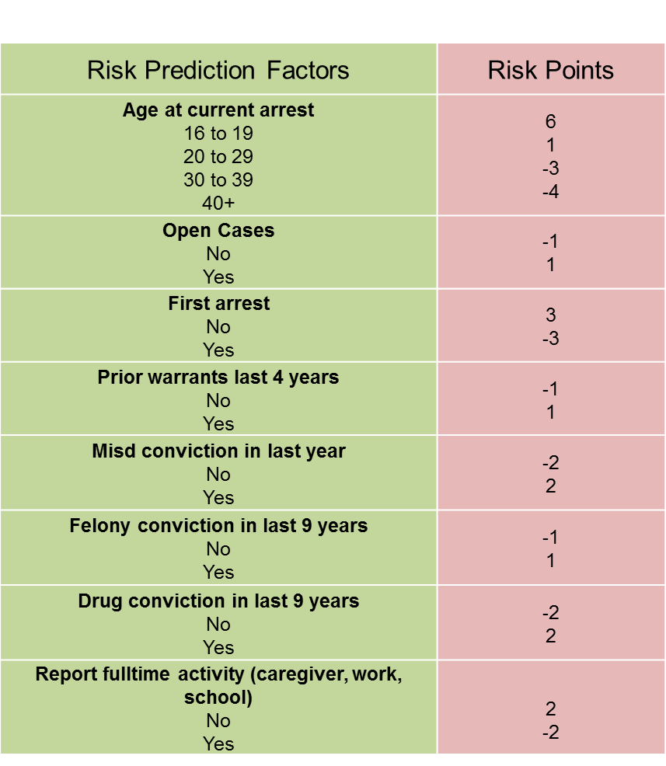
Supervised Release Risk Tool

Slide 8
Supervised Release Risk Tool
Risk Category | Risk Points
Low | lowest through -10
Medium Low | -9 through -5
Medium | -4 through 0
Medium High | 1 through 4
High | 5 through highest

Slide 9
NYC Supervised Release Process Flow
Pre-Arraignment
Risk Tool Screening
Permission from Defense
Client Interview
Providers Identify Cases/Cases Referred by Defense

Slide 10
NYC Supervised Release Process Flow
Arraignment
SR staff speaks on record (if needed)
Judge makes release determination
Released on SR per Judge
Defense advocacy for eligible cases
SR contract signed in court

Slide 11
NYC Supervised Release Process Flow
Post-Arraignment
Supervision
Voluntary
Referrals
Intake
Needs Assessment
Compliance Reporting
ASAP but within 48 hours

Slide 12
Non-Compliance
Within 24 hours of a missed appointment or call the provider will reach out to the defense attorney and any other contacts given by the client
Within 48 hours of a missed appointment or call, if the provider has had no contact from the client, the provider will inform the court via email and provide a written letter to the appropriate court part

Slide 13
Risk Management/ Community Supervision
All levels | phone call/text message court reminders
 | criminal history check before each court date
Level 1 | One face to face contact per month - planning phone call before court date
Level 2 | One face to face contact and two phone calls per month
Level 3 | Two face to face contacts per month and two phone calls
Level 4 | One face to face contact and one phone call per week

Slide 14
Risk Management/ Community Supervision
SR Risk Category | Misdemeanor | Misdemeanor with aggravating factors | Non-violent felony offenses | Non-violent felony offenses with aggravating factors
low | 1 | 2 | 1 | 2
low-med | 1 | 2 | 1 | 2
medium | 2 | 3 | 2 | 3
med-high | 2 | 4 | 3 | 4
high | ineligible

Slide 15
Continuous Feedback & Improvement
Discussion Forums
Trouble
shooting
Measuring Improvements

Slide 16
www.pretrial.org
/pretrial
@pretrial
pji@pretrial.org

