Slide 1
LISTEN & LEARN, SEEN & HEARD:
FAMILIES KNOW BEST
History and Harms of Removal and Family Separation
June 1, 2023
Professor Dorothy Roberts
George A. Weiss University Professor of Law and Sociology & Raymond Pace and Sadie Tanner Mossell Alexander Professor of Civil Rights, University of Pennsylvania
Shereen A. White
Director of Advocacy & Policy, Children’s Rights

Slide 2
OVERVIEW
History of Family Separation,
Practices & Policies
Context for individual, collective, and intergenerational historical trauma
Impact of Family Separation Practices & Policies
Current research and data on negative outcomes for removed children
The System was Designed this Way
Abolitionist organizing to dismantle, reimagine, and create

Slide 3
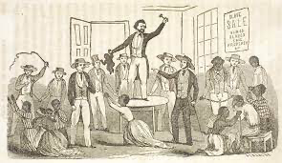
THE ROOTS OF FAMILY POLICING:
Slavery, Black child apprentices, Indigenous boarding schools, orphan trains
Mandatory Reporting

Slide 4
1912 – 1960s: FORMALIZATION OF THE
U.S. CHILD WELFARE SYSTEM
“The final purpose of the Bureau . . . is to serve all children, to try to work out the standards of care and protection which shall give to every child his fair chance in the world.”
1912
Congress passed legislation creating the Children’s Bureau
1923
Over 60% of agencies in norther states were still reserved for white children
1940s
“Children are not safe and happy if their parents are miserable, and parents must be miserable if they cannot protect a home against poverty.”
Agencies began to include Black children
Mandatory Reporting
1960s
States enacted mandated reporting laws

Slide 5

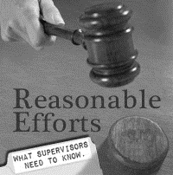
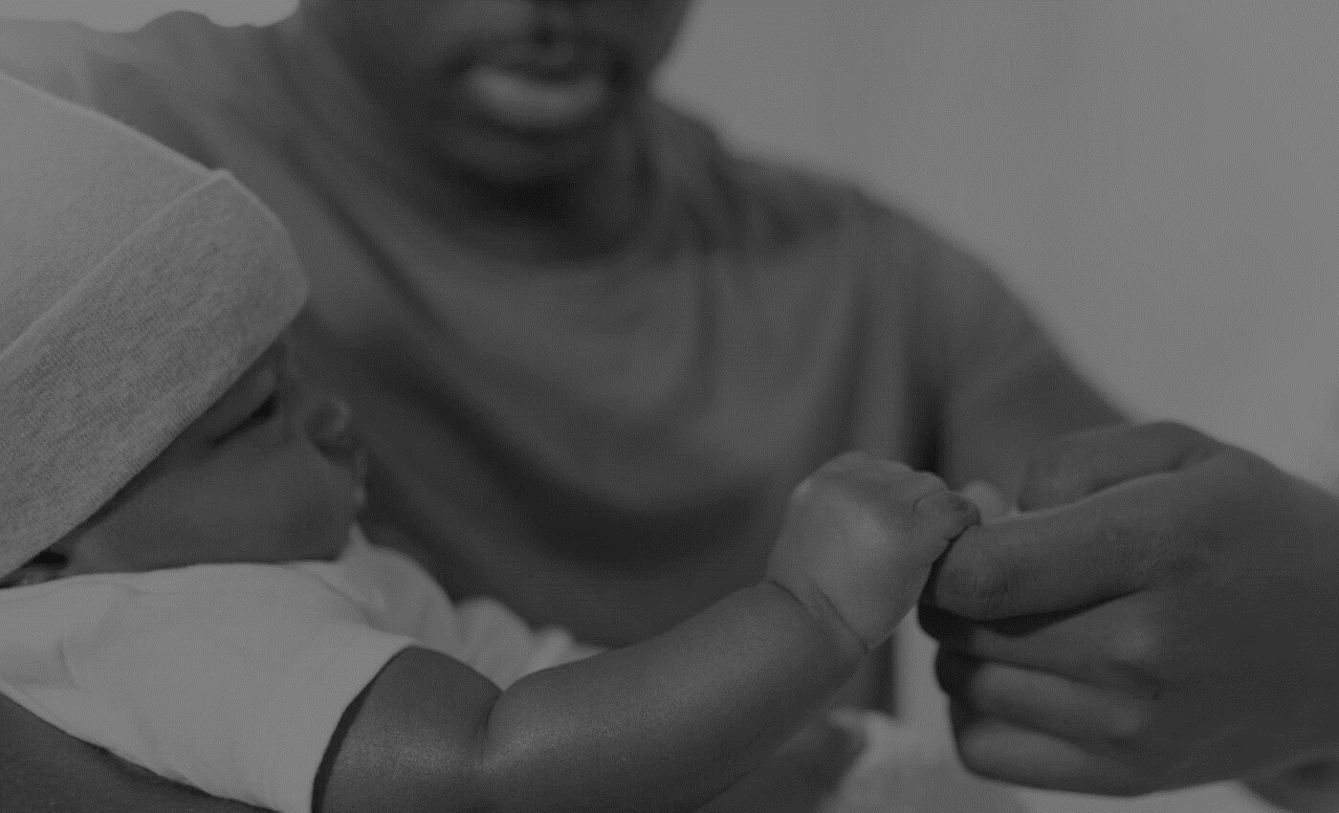

1970s – PRESENT: FAMILY SEPARATION AFTER THE FORMALIZATION OF THE CHILD WELFARE SYSTEM
1974
1980
1997
Mandatory Reporting
CAPTA
AACWA
ASFA
Conditioned federal funding on enactment of reporting laws
Expanded reporting requirement to include neglect
Introduced the vague, undefined “reasonable efforts” requirement
Introduced the 15/22 month timeline and financial incentives for states to increase adoptions

Slide 6
CARCERAL POLICIES
Violent Crime Control & Law Enforcement Act (1994)
Personal Responsibility & Work Opportunity Reconciliation Act (1996)
Adoption & Safe Families Act (1997)
Mandatory Reporting

Slide 7
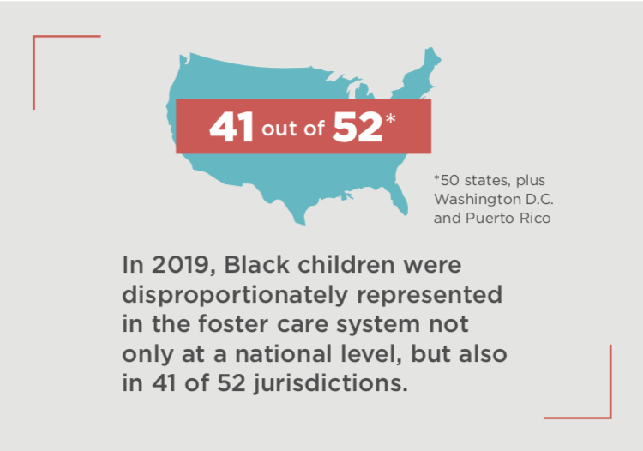





RACIAL DISCRIMINATION
IN THE U.S. CHILD WELFARE SYSTEM
Black children represent 14% of the child population and 22% of children in the foster system.
Reporting
Investigation
Substantiation
Removal
Outcomes

Slide 8


RACIAL DISCRIMINATION
IN NEW YORK’S CHILD WELFARE SYSTEM
Black children represent 15% of New York’s child population and 38% of children in the foster system.
Black children represent 23% of New York City’s child population and 52% of children in the foster system.
Analysis by Children’s Rights Advocacy & Policy Department, AFCARS 2021Dataset

Slide 9
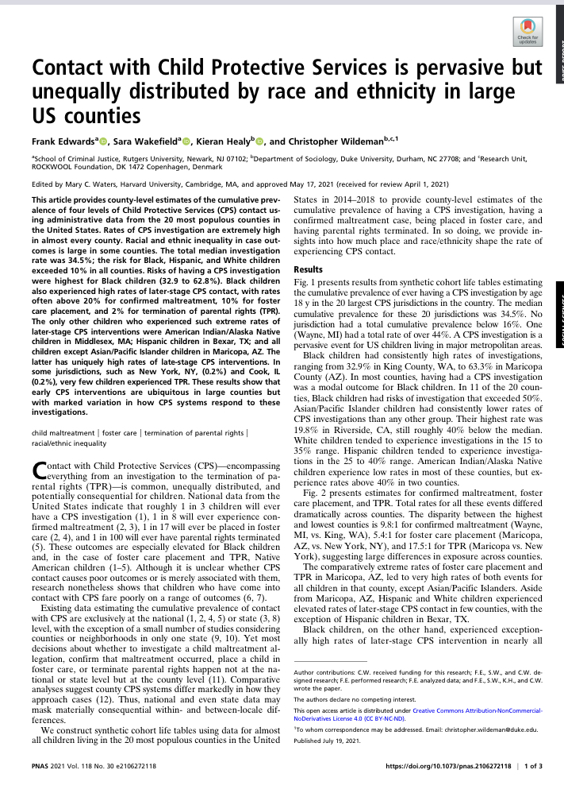
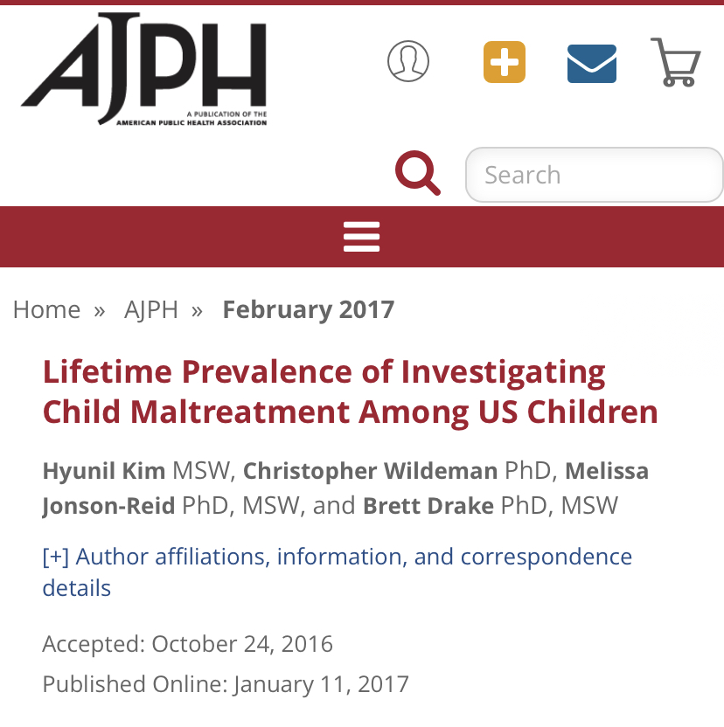
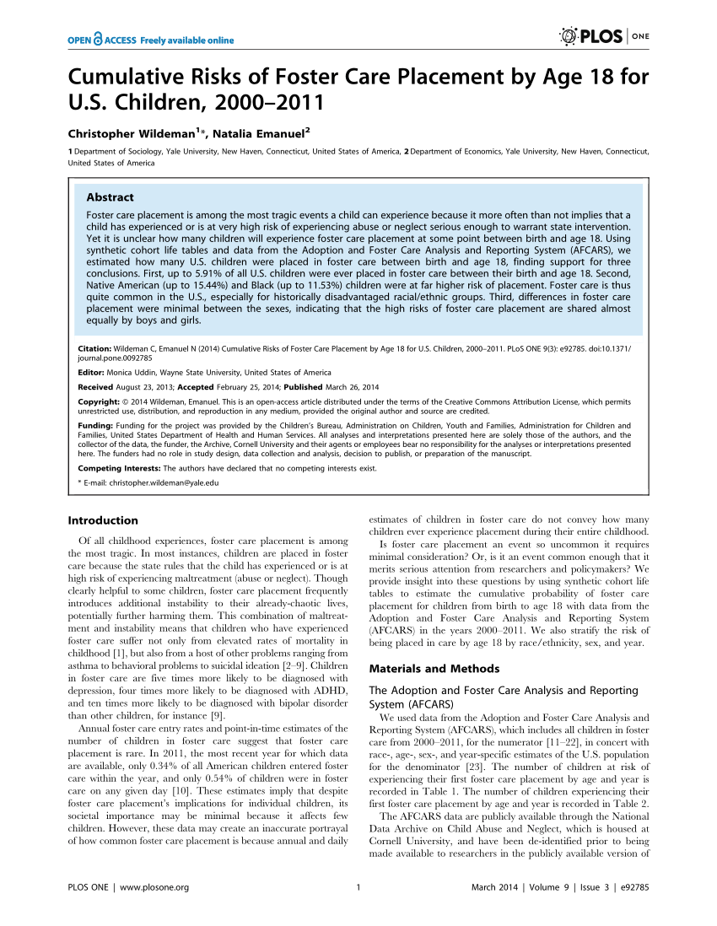
“Foster care is thus quite common in the U.S., especially for historically disadvantaged racial/ethnic groups.”

Slide 10
STRUCTURED TO HARM
“No one really tells you about the mental abuse that the foster care system will put you through. How you become more unstable than you probably were before. How you become a liability and you’re bound by all these regulations for your ‘well-being’ and your ‘safety.’ How you really are treated like you’re disposable: you really are given a trash bag—that’s not just a story they tell. You are made to feel like you are temporary, and to not get too comfortable because you’re not family.”
Athena Garcia-Gunn, TEDx (2017)
Mandatory Reporting

Slide 11
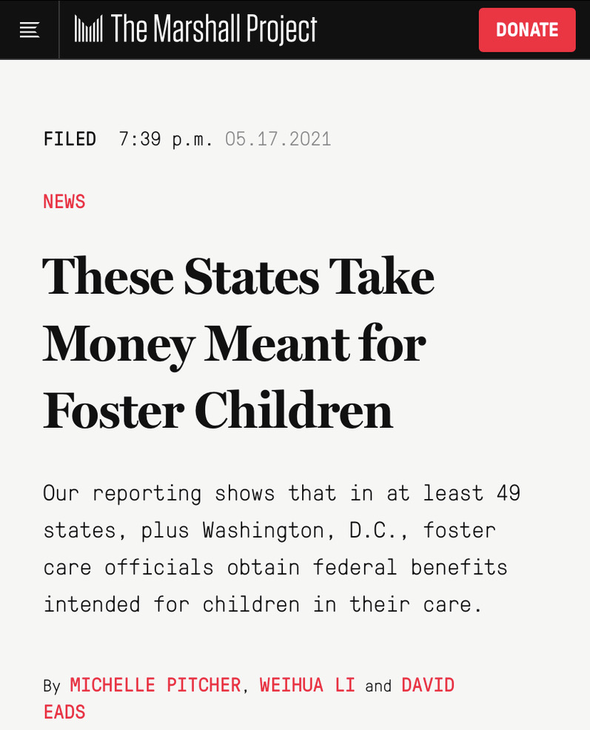
PREYING ON CHILDREN: “REVENUE MAXIMIZATION”

Slide 12
CRIMINALIZING BLACK CHILDREN
Cornelius Fredericks, 2020;
David Hess, 2016
“frequently compared institutional placements to prison, as institutional placements have many functions of a carceral environment: confined, surveilling, punitory, restrictive, and degrading.”
“locked away” “a hostage”
“a criminal”
“a dog in a cage”
Mandatory Reporting
Think of Us, Away from Home (2021)

Slide 13
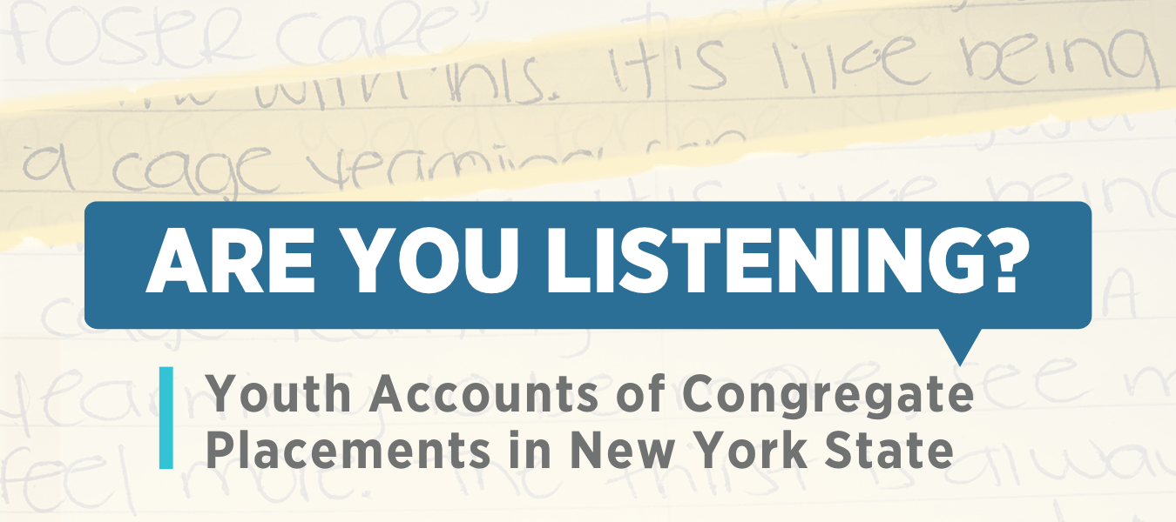

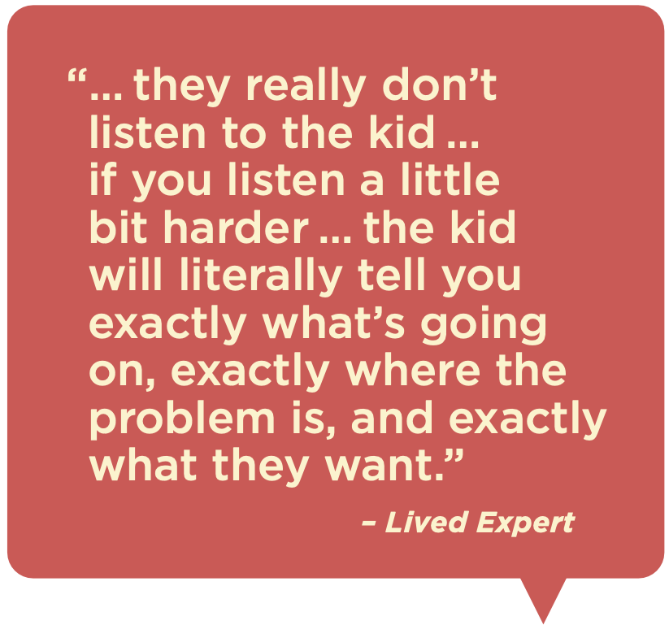




Slide 14
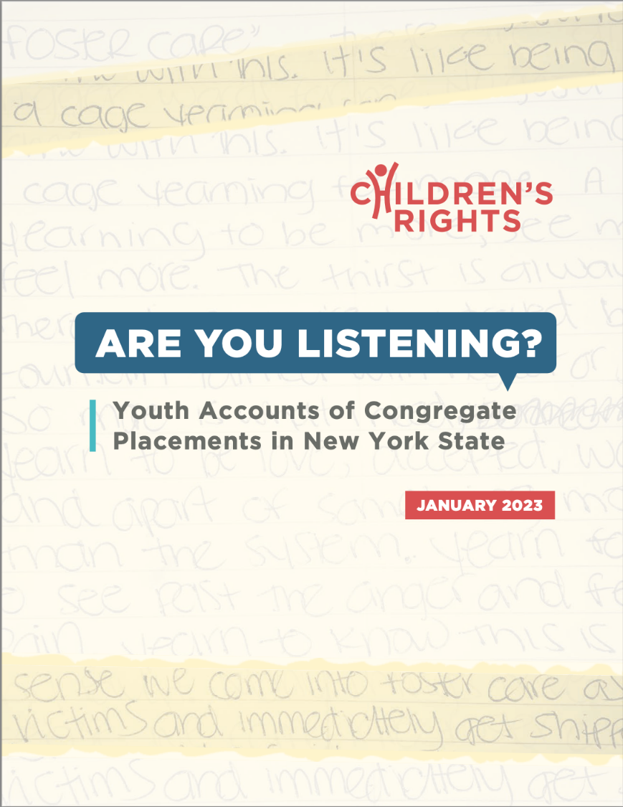
What is the “are you listening” Report?
An amplification of detailed experiences of 80 young adults who experienced these harmful settings throughout NYC and NY state
An overview of why we need to act now in NY
A roadmap for how we can partner with lived experts to eliminate these harmful settings
A localized companion to CR’s 2021 Families Over Facilities Report that spotlights what it is like to live in congregate settings

Slide 15
Why Focus on New York State?
Despite reforms, NYS has maintained one of the highest congregate placement rates among states with a large foster system census
NYS has ~2000 youth in congregate settings
NYS disproportionately places Black youth in congregate settings
Black youth are 13x more likely to stay in care compared to white youth in NYC
1 in 6 youth placed in NYS are under the age of 13
NYS permits physical restraints and seclusion. The deadliest type of restraint, a face-down or “prone” restraint, was only banned in 2021
NYS still uses emergency group shelters that have little oversight

Slide 16
What lived experts report
Key findings

Slide 17
Youth experience a carceral environment
“All the walls were pretty much, they weren’t brick, but they were like cement block. So very prison-like. And our windows weren’t like actual windows, we have those glass blocks that couldn’t break ... yeah, we couldn’t see any of them. And we didn’t have any windows that opened either.”
Severe limitations around phone use, bathroom use, and free movement
Unsanitary conditions
Poor food quality and quantity, with snacks often withheld as punishment
Low quality and inadequate hygiene products inappropriate for most youth, especially Black youth
A lack of essential clothing and apparel, especially for cold weather
Medical negligence or lack of medical care when sick or injured
Misdiagnosis of conditions, over-prescription of medication, or prescription of incorrect medication

Slide 18
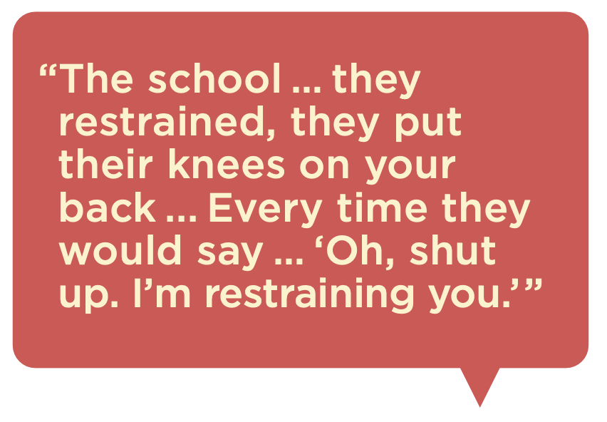
Youth feel unsafe
Severe punishments including restraints, seclusion and isolation, police calls
Unsafe and threatening treatment from staff causing stress and fear
A culture among youth often involving conflict, physical altercations, and bullying
Disparate treatment for LGBTQ+ youth due to their gender expression or sexuality

Slide 19
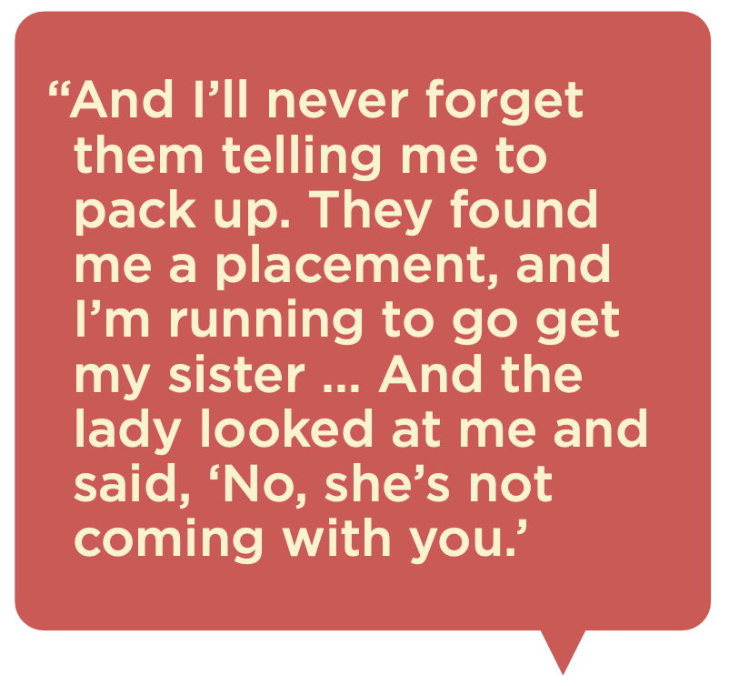
Youth feel lonely
Staff perceived as uncaring, apathetic, aggressive, and untrustworthy
Disconnection from family and friends, compounded by restrictions on communication and visits

Slide 20
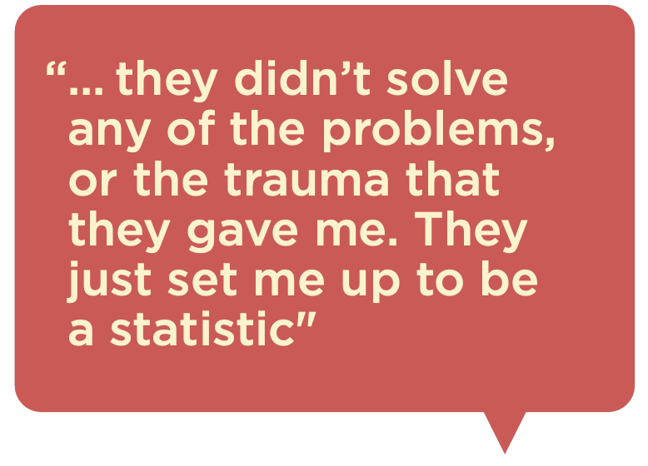
Youth endure lasting barriers to stability
Poor academics in congregate placements left youth under-credited and unprepared for future education and career
Feeling emotionally unprepared for independent living, and exiting the system involved issues with housing, employment, and economic insecurity

Slide 21
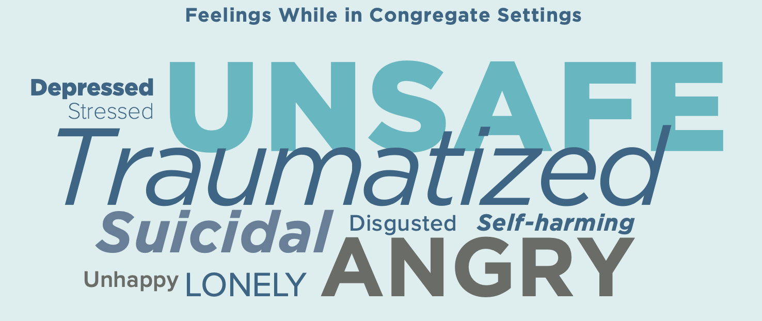
Youth endure lasting barriers to Well-being
Youth experienced a deep sense of hopelessness, mentioning lasting trauma, anger, depression, and persistent challenges with one’s emotional well-being and mental health

Slide 22
What lived experts call for
recommendations

Slide 23
Partner with lived experts to co-design practices that lead to the elimination of congregate placements.
Eliminate the use of pre-placement facilities and emergency group shelters, such as the ACS Children’s Center.
Evaluate the standards of care in Qualified Residential Treatment Programs.
Depopulate existing congregate settings that house youth by prioritizing case reviews, reunification/kinship/guardianship, and high-level approval for new group placements.
Ban the use of all restraints and other punitive practices while we are working towards the elimination of congregate placements.

Slide 24
Preserve and support families of origin. keep children at home, prevent removals, and increase Community supports.
Adopt policies and practices that increase financial and social supports to help families stay together in the first place.
Expand the availability and affordability to community mental health resources.
Address inequitable application of the “reasonable efforts” standard- balancing the risk of imminent harm with the risk of removal when determining what is in the child’s best interest.
Reinvest savings from depopulating congregate settings into preserving families.
Increase utilization of, and remove barriers to, kinship placements for youth who absolutely cannot remain at home.

Slide 25
Increase transparency and accountability around congregate practices.
Share congregate placement data publicly, such as on restraints, AWOLS,
police-calls, license violations, critical incident reports, notices of Heightened Monitoring State, and any Performance Improvement Plans in response to violations.
Create an independent commission of experts, including lived experts, to evaluate staff conduct and treatment of youth in congregate settings.
Establish a process for youth to share maltreatment concerns occurring in congregate settings.

Slide 26
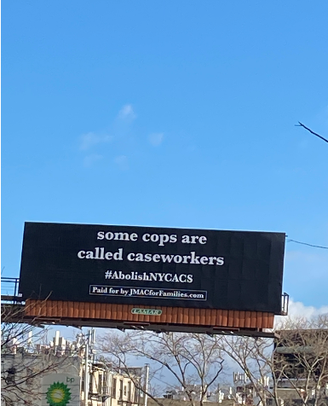
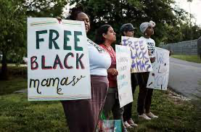
THE CARCERAL WEB

Slide 27
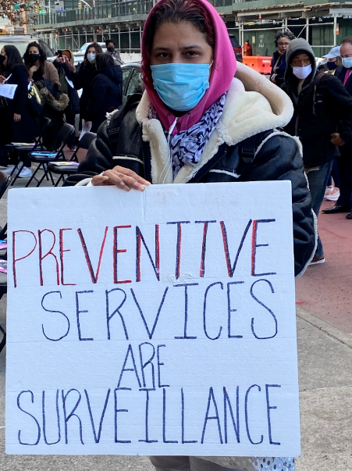
CARCERAL LOGIC
Structured to Impede Care, Resistance & Social Change
Child maltreatment as parental pathology & cognitive deficits in need of therapeutic cures & supervision

Slide 28
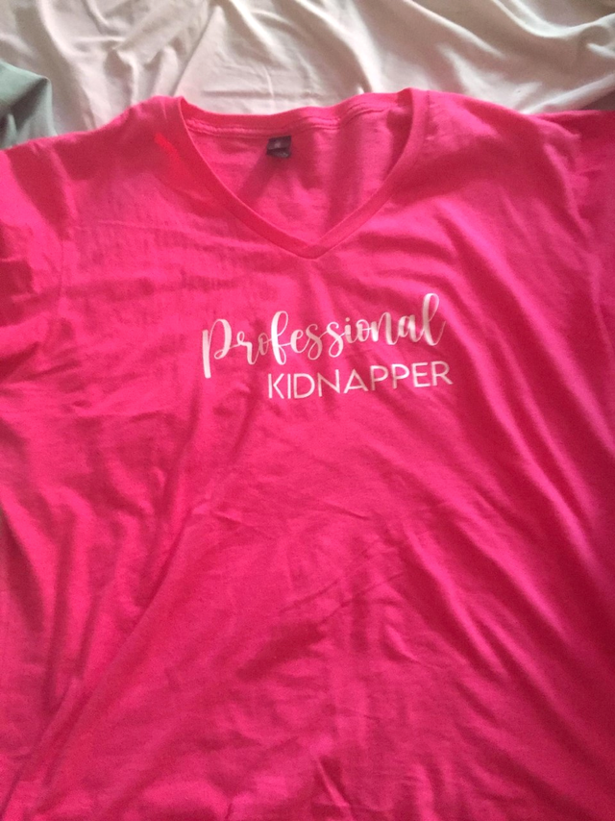
NOT A MALFUNCTION – THE SYSTEM’S DESIGN

Slide 29
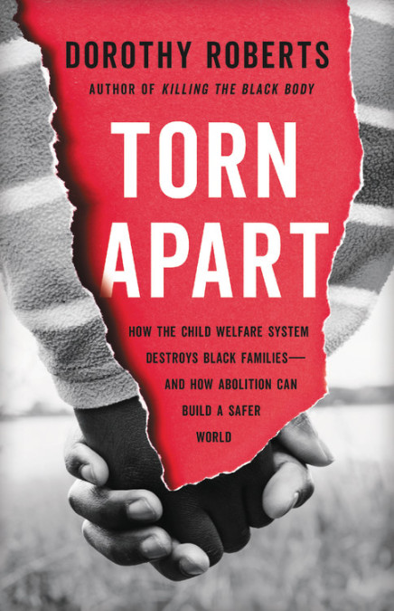

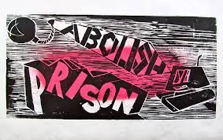
FROM REFORM TO ABOLITION

Slide 30

ABOLITION
“Abolition means completely dismantling this system of family policing—not reforming it or replacing the current system with a new and improved system. It means ending its philosophy, design, practices and policies and building a different way of caring for families.”
-Dorothy Roberts
“Abolition is a verb, a practice. It consists of the actions we take to build safety and to tear down harmful institutions. People do abolition every day when they connect to their community, learn how to take accountability, and foster communal responsibility for preventing and responding to harm.”
-Derecka Purnell
An invitation into finding new answers to the problem of harm and into building new ways to prevent harm in the first place.

Slide 31
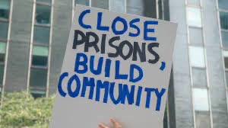
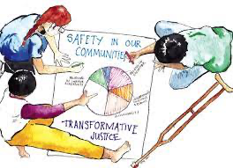

ABOLITIONIST ORGANIZING
Dismantle, Reimagine, Create

