Slide 1
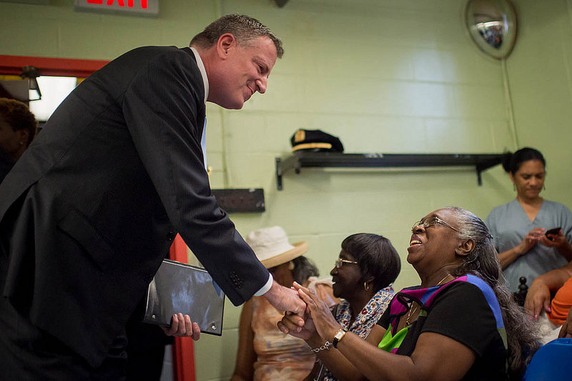
The mayor’s TASKFORCE ON BEHAVIORAL HEALTH and THE CRIMINAL JUSTICE system
Trish Marsik, Executive Director
March 31, 2016

Slide 2
Average Daily Population (FY 2011-2015)
12,790
12,287
11,827
11,408
10,240
32%
34%
37%
38%
41%

Slide 3
THE Goals
Ensuring for people with behavioral health issues:
Avoid the criminal justice system in the first place;
treated outside of a jail setting;
receive therapeutic interventions;
connected to service

Slide 4
The Action Steps
Behavioral Health training for first responders
1458 TRAINED
Public Health Diversion Centers

Slide 5
The action steps
Behavioral health screenings >5000 COMPLETED
Connection to services for vets >450 screened to VA
Supervised release programs 3,400 slots March 2016
Risk assessment pilot program
Shortened case processing times
Reduced reliance on monetary bail

Slide 6
The Action Steps
De-escalation strategies
Crisis Intervention Teams
Ongoing revisions to the DOC’s use of force policy
Programming and staffing strategies
Specialized units that provide preventative services
Reduce punitive segregation
Specialized services for adolescents, including trauma-informed care
Plan for substance use disorder treatment expansion
Plan for idle time and violence reduction programming

Slide 7
The action steps
Increase access to Medicaid
Expand discharge programing
Connections to Health Homes
Agency coordination around discharge planning

Slide 8
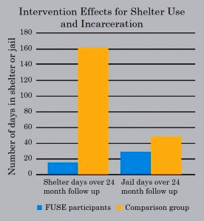
The Action steps
Supportive, permanent housing
Behavioral health services team at Probation
Housing planning team
Employment and paths to self-sufficiency
Source: CSH- The NYC Fuse program
FUSE, a Corporation of Supportive Housing (CSH) initiative, helps identify and engage high users of public systems and place them into supportive housing. Their evaluation indicates that supportive housing can reduce homelessness, incarceration and costs of public stems.

Slide 9
THE TASK FORCE AND Medicaid

Slide 10
THE impact
Ongoing public interface
Cost-benefit evaluation
Agency specific performance indicators
Use data to identify opportunities for improvement

