Slide 1
A MODEL FOR NEXT STEPS: CONVENING A SCHOOL-JUSTICE TASK FORCE AND CREATING A ROADMAP
Kathleen R. DeCataldo, Esq.
March 7, 2014
Notes:
Introduce self
Thank Planning Team, NYCLU volunteers, Toni Lang and especially JSK for her leadership in bringing this issue to the forefront both locally and nationally

Slide 2
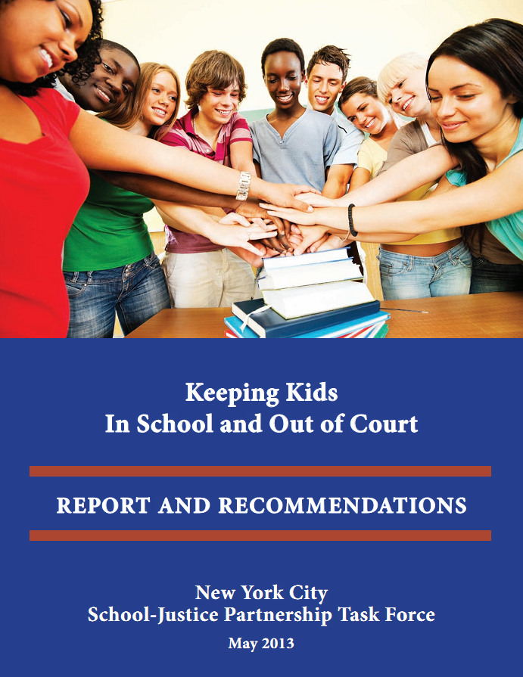
Notes:
Judge Kaye convened in 2011
Report is a distillation of
18 months of meetings
Literature search
expert interviews and presentations
Data analysis
Focus groups Judges, teachers, principals, dignity in schools
School visits
Data analysis
Weeks of deliberation
Report released in 2014
We hope that breaking this down can give you ideas on how to approach next steps

Slide 3
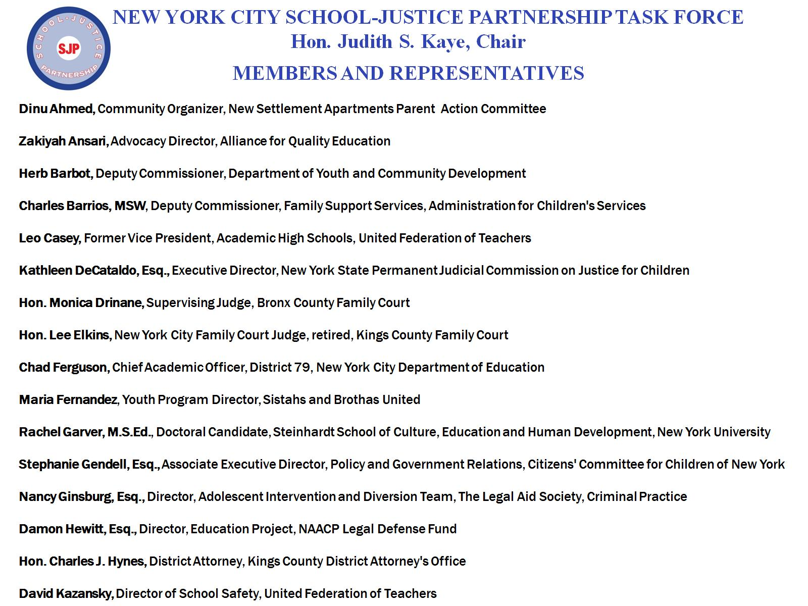
Notes:
CLIck CLICK CLICK
Diverse Group
Judges
Community
Parents
UFT & CSA
NYC DOE DAs
ACS
Advocacy groups: AFC, CCC
Attorneys
National experts
Academia

Slide 4
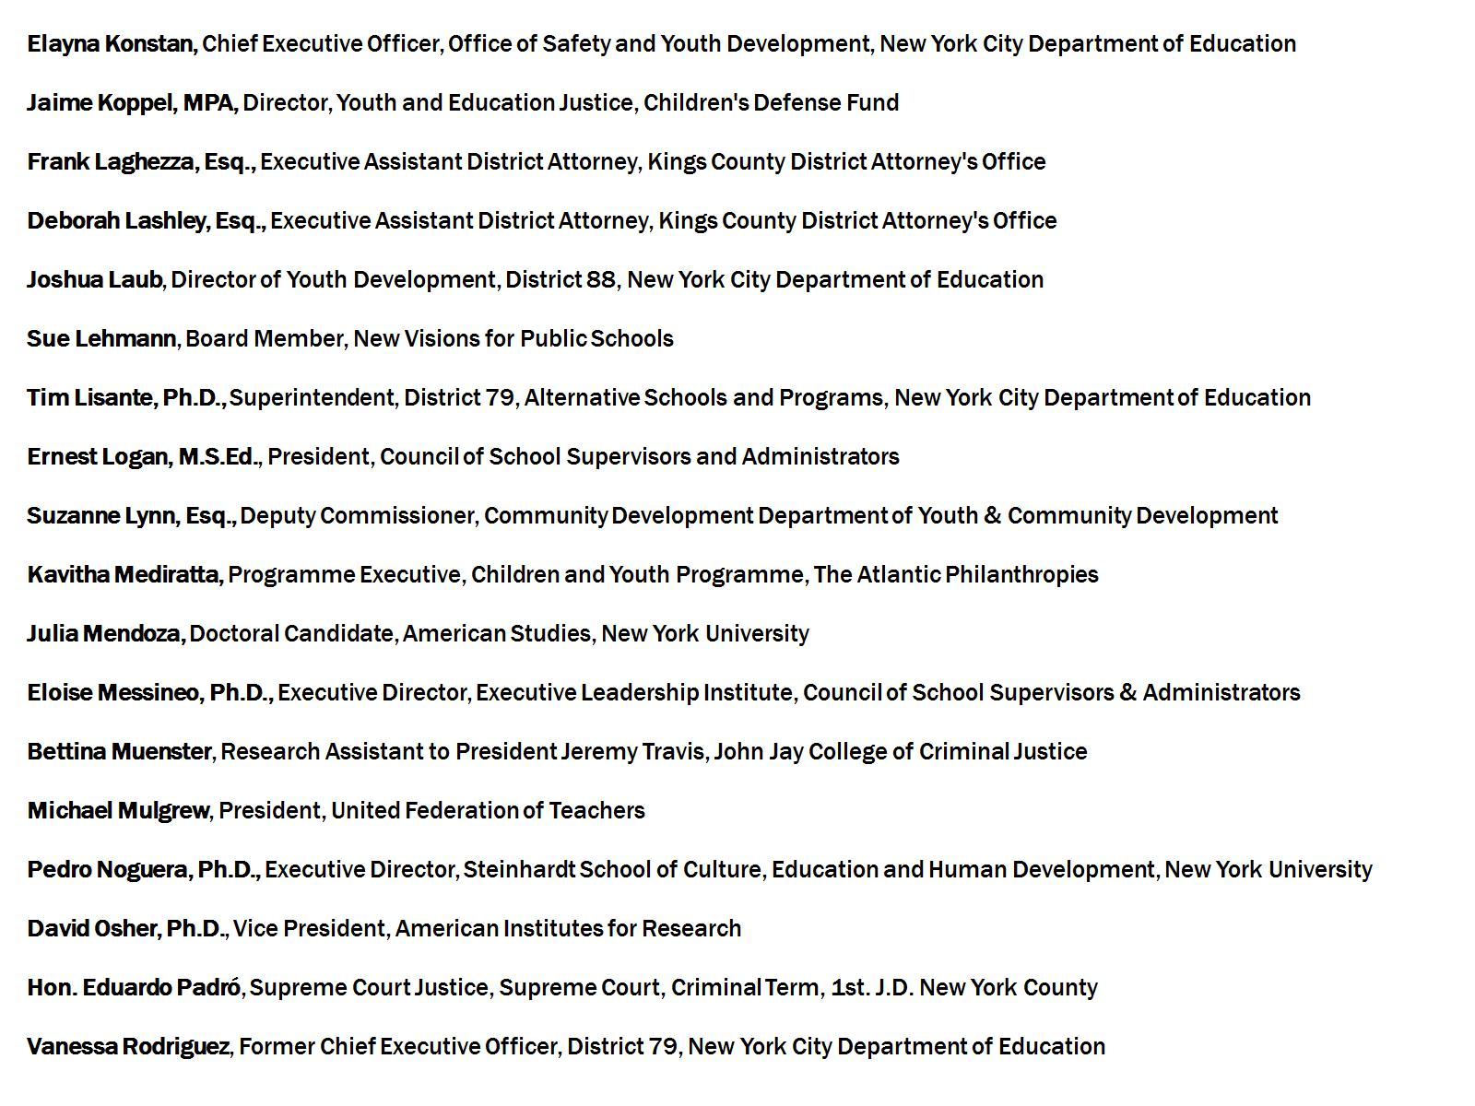

Slide 5
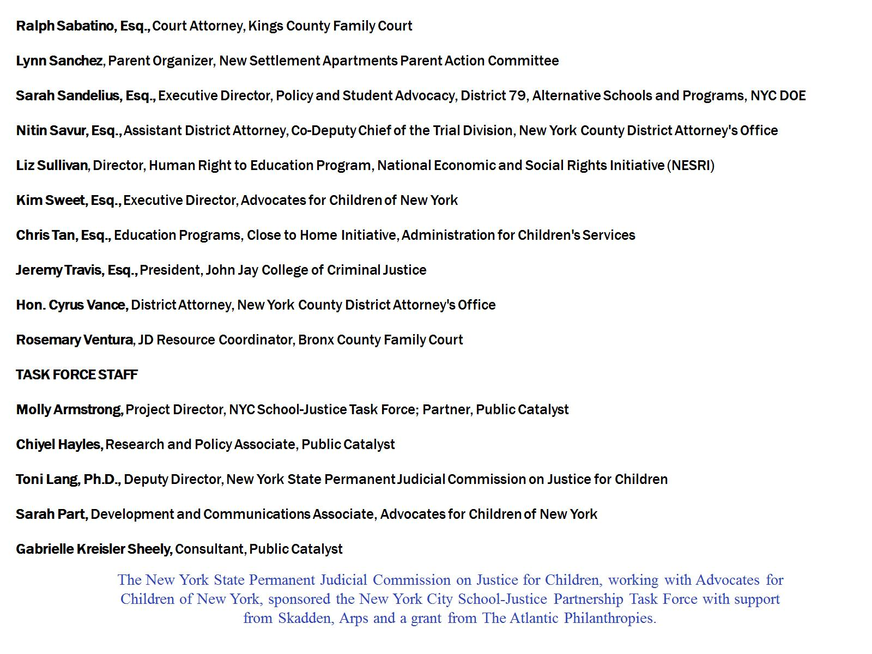

Slide 6
Bottom line – school and justice outcomes intertwined
Youth with Discretionary Suspensions at Increased Risk of Contact with Justice System
Risk of Justice System Contact
VS.
Not Suspended
Discretionary Suspended
Source: Fabelo, T., M. D. Thompson, M. Plotkin, D. Carmichael, M.P. Marchbanks and E.A. Booth. 2011. Breaking Schools’ Rules: A Statewide Study of How School Discipline Relates to Students’ Success and Juvenile Justice Involvement. New York: Council of State Governments Justice Center. http://knowledgecenter.csg.org/kc/content/breaking-schools-rules-statewide-study.
Notes:
FINDINGS: REALLY A REVIEW OF WHAT YOU HEARD TODAY
Slide shows that Youth with discretionary - NOT zero tolerance - suspensions are 3X as likely to have later contact with the Justice system
Moreover,
OUT-OF-SCHOOL SUSPENSIONS are linked to FALLING BEHIND in school, FAILING a grade, DROPPING OUT of school, committing a CRIME and becoming INCARCERATED as an adult. Multiple suspensions exacerbate the effects.²
· STUDENTS SUSPENDED 3 or more times by 10th grade are 5 times more likely to DROP OUT compared to peers with fewer or no suspensions.³

Slide 7
Bottom line – school and justice outcomes intertwined
Youth with First Arrests at Increased Risk of Dropping Out
Risk of Dropping Out
VS.
No Arrest
Youth with First Arrest
Source: Sweeten, Gary. 2006. “Who Will Graduate Disruption of High School Education by Arrest and Court Involvement.” Justice Quarterly, 23(4): 462-480.
Notes:
First arrest almost 2 times more likely to drop out of school (Sweeten, 2006)

Slide 8
Bottom line – school and justice outcomes intertwined
Youth with First Arrest and Court Appearance at Greater Risk of Dropping Out
Risk of Dropping Out
VS.
No Arrest
First Arrest and Court Appearance
Source: Sweeten, Gary. 2006. “Who Will Graduate Disruption of High School Education by Arrest and Court Involvement.” Justice Quarterly, 23(4): 462-480.
Notes:
Youth with Court appearance following first arrest are nearly 4 times more likely to drop out of school (Sweeten, 2006)

Slide 9
Bottom line – school and justice outcomes intertwined
Youth with Juvenile Court Involvement at Greater Risk of Future Adult Criminal Records
Risk of Adult Criminal Records
VS.
No Juvenile Involvement
Juvenile Involvement
Source: Gatti, U., R. Trembley and F. Vitaro. 2009. “Latrogenic effect of juvenile justice.” Journal of Child Psychology and Psychiatry. 50(8): 990-998.
Notes:
Low income youth with juvenile court involvement are 7 s more likely to have adult criminal records compared to youth with same background/no court involvement (Gatti et al., 2009)
-… All of this strongly suggested that we are not going to make the progress we need to make on improving academic outcomes, or on reducing crime, unless we address troubling rates of suspensions, summonses, and arrests in schools
-on the flip side, we were encouraged by what we learned from places like LA and Baltimore, which had reduced their suspensions considerably while increasing indicators of academic achievement, such as test scores and graduation rates.
-So, we started to delve further into NYC’s data.

Slide 10
NYC Council Student Safety Act
Biannual report by the NYC DOE on Suspensions
Reported by:
school
discipline code infraction
age
race/ethnicity
gender
grade
special education status
English language proficiency
http://www.nyclu.org/schooltoprison/ssa accessed 11.13.13
Notes:
Ideal time for TF to be convened

Slide 11
NYC Council Student Safety Act
Quarterly reporting by the NYPD on arrests and summonses (tickets) issued by officers in the NYPD’s School Safety Division.
Broken down by:
penal code
patrol borough
gender
race/ethnicity
age
http://www.nyclu.org/schooltoprison/ssa accessed 11.13.13
Notes:
The TF came together and then coalesced around the data. The data played a big role in the defining the problem that we needed to address.

Slide 12
Enrollment, Suspensions and Arrests by Race/Ethnicity: NYC Schools, SY2012
Source: Enrollment: New York City Department of Education, J-Form; Suspensions: New York City Department of Education, Student Safety Act data; Arrests: NYPD, Student Safety Act data.
Notes:
FACTS: IN NYC
First Bar is enrollment, 2nd is suspensions, last is arrests. Peachy color represents black students in NYC schools.
Total of 69,000 suspensions
·

Slide 13
Enrollment and Suspensions by Iep status: NYC schools, sy2012
Source: NYC Department of Education, School Safety Act data.
Notes:
-We also found disturbing disproportionality for students with IEPs
-We were not able to see arrest data broken down by IEP status
-Interestingly, even though suspension rates went down in SY2012, the rates of disproportionality for both black students and students with IEPs have not improved.

Slide 14
Disproportionality
Black students compared to White Students
4x more likely to be suspended
14x more likely to be arrested
Hispanic students compared to White Students
2x more likely to be suspended
5x more likely to be arrested
Students receiving special education services compared to students not receiving services
4x more likely to be suspended
Source: NYS Permanent Judicial Commission on Justice for Children. 2012. Relative Risk Analysis of SY2012 School Safety Act data.
Notes:
Bottom Line

Slide 15
school-based arrests by age: NYC schools, 7/1/11-6/30/12 (N=882 arrests)
Family Court Jurisdiction
Adult Criminal Court Jurisdiction
Source: NYPD, School Safety Act data.
Notes:
age determines whether the student will wind up in Family Court or Criminal Court
-[explain the split in responsibility for the school-age population]
Judge Corriero’s Presentation

Slide 16
Distribution of school-based arrests by offense level: NYC schools, 7/1/11-6/30/12 (N=882 arrests)
Source: NYPD, School Safety Act data.
Notes:
-
FACTS:
· Nearly 3 out of 4 of the 882 arrests during SY2012 were for misdemeanors (70%) or violations (4%).
· Obstructing governmental administration or resisting arrest accounted for 1 out of every 6 arrests in SY2012.

Slide 17
Bronx County Family Court caseload study: Proportion of school-related petitions filed, 11/23 to 12/16/11 and 1/23 to 2/10/12 (N=175 petitions)
Source: Bronx County Family Court Survey, 2012.
Notes:
-We wanted to look further into the perception of the judges on the task force that they were spending a large portion of their time on school-related incidents
-Thanks to TF member Monica Drinane, Supervising Judge of Bronx Family Court, we were able to gain access to Family Court petitions filed in the Bronx from 11/23 to 12/16/11, and from 1/23 – 2/10/12.
T

Slide 18
Data Released Since Report
SUSPENSIONS: NYC SCHOOLS, SY2012 VS. SY2013
Students of color continue to be disproportionately suspended from school at the same rates as in the past
Rate at which students with disabilities are suspended actually increased slightly
Notes:
Data just released for the fall of 2013 shows an overall 26% increase in suspensions
Students of color continue to be disproportionately suspended from school at the same rates as in the past
Rate at which students with disabilities are suspended actually increased slightly

Slide 19
Data Released Since Report
SCHOOL-BASED ARRESTS AND SUMMONSES: NYC SCHOOLS, July 1 to December 31, 2011 vs. July 1 to December 31, 2012
Notes:
This is 6 months of arrest data

Slide 20
TASK FORCE RECOMMENDATIONS AND STRATEGIES
Notes:
--Consistently heard from TF members
schools cannot meet this challenge alone
-

Slide 21
Adopt Graduated Response Protocol
Re-Engage Placed and Sentenced Youth
A
Build Capacity
Mayoral Lead Citywide Initiative
E
B
D
C
Improve Planning for Court-Involved Youth
Focus Role of SSA
Notes:
Not going to spend a lot of time on the individual recommendations. Each recommendation has action steps that may be something your jurisdiction or school district may want to consider
In NYC we recommended that because the schools are under Mayoral control, that the mayor convene a leadership team.
I can hear you all thinking what does that have to do with us??? WE are not NYC. We know that - however, I’d like you to think about the underlying premise of these recommendations.
Judge Teske talked about a judicially led team in Georgia. All day, speakers have lifted up the need for collaboration and community involvement to make a the changes we want to see to keep kids in school and out of court.
We would like you all to think about how to build a collaboration around schools that brings together key stakeholders to talk about common goals and what resources can be brought to the table.

Slide 22
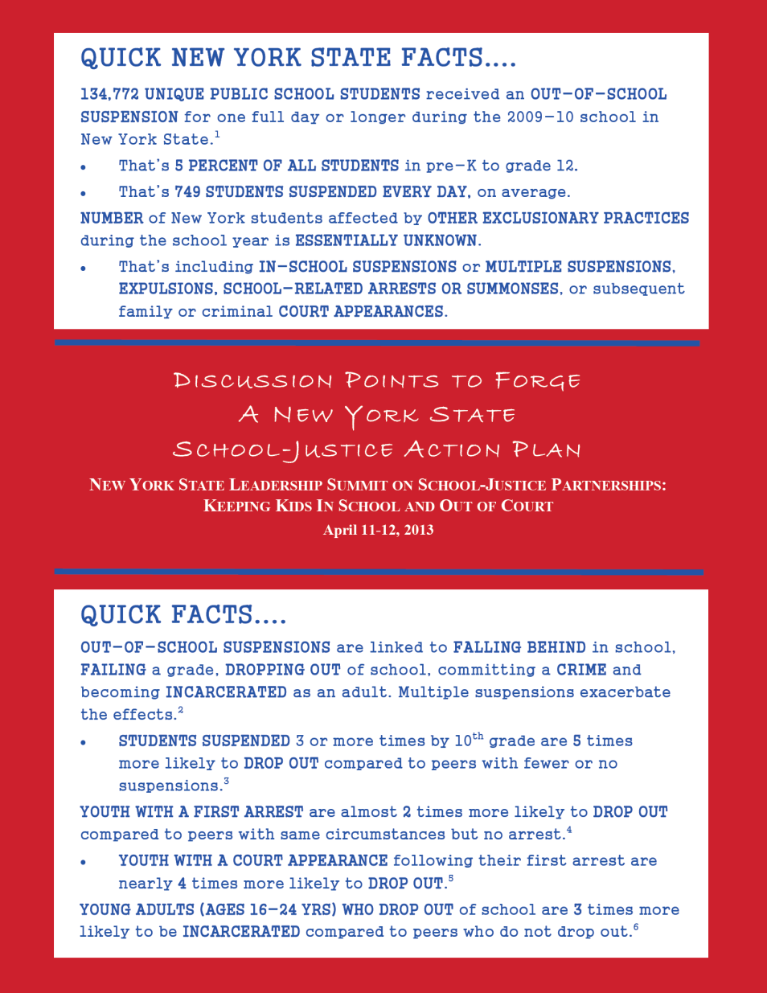
Notes:
Highlight one other resource you received today that may assist your future discussions

Slide 23
New York State Juvenile Justice Strategic Planning Action Committee
Regional Youth Justice Teams
Notes:
Partner in the Summits - DCJS
Introduce Tom Andriola- Tom serves as the Director of Policy and Implementation for Governor Cuomo’s
Office of the Deputy Secretary for Public Safety.

Slide 24
Regional Youth Justice Teams – County Breakdown
Finger Lakes: Lead Entity – The Monroe County Probation Department
Contact: Bob Burns (rburns@monroecounty.gov) or Courtney Ramirez (Courtney.Ramirez@dcjs.ny.gov)
Chemung, Livingston, Monroe, Ontario, Schuyler, Seneca, Steuben, Wayne, Yates, Genesee, Orleans, Wyoming
Next Meeting: June 13, 2014
Western New York: Lead Entity – The Erie County Probation Department
Contact: Brian McLaughlin (brian.mclaughlin@erie.gov) or Courtney Ramirez (Courtney.Ramirez@dcjs.ny.gov)
Allegany, Cattaraugus, Chautauqua, Erie, Niagara
Next Meeting: June 12, 2014

Slide 25
Central Region Leadership Summit
NEXT STEPS
Notes:
Send you off to the Brainstorming sessions.
Monroe County - here
Erie County
Other

Slide 26
Kathleen R. DeCataldo, Esq.
Executive Director
NYS Permanent Judicial Commission on Justice for Children
150 State Street
Albany, NY 12207
518-285-8780
pjcjc@nycourts.gov

